Slide 1

Implementing Drupal Four Perspectives.
Brock University
Meron James Hrycusko
McGill University
Karl Jarosiewicz , Andrew Lindsay
University of Waterloo
Eva Grabinski ,Kris Olafson
University of Windsor
Vlad Pavlovic ,Richard Dumala

Slide 2




Our brand…….

Slide 3

Didn’t make the cut

Slide 4
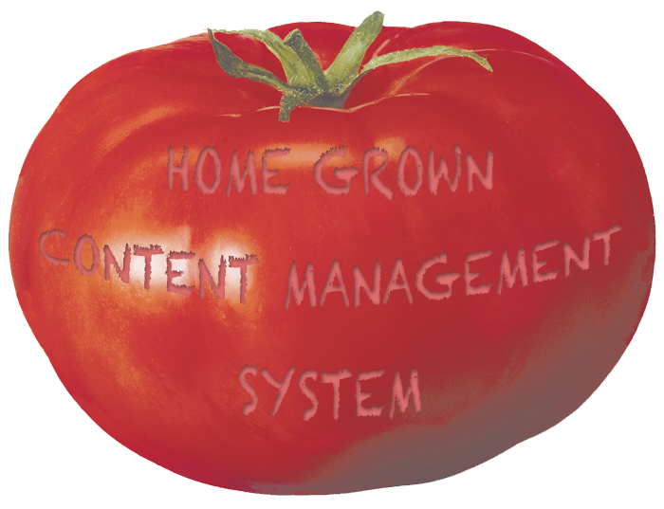
In the beginning…

Slide 5
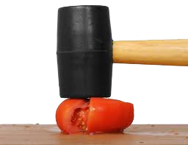
and then in 2008….
A consultant arrived on scene and….

Slide 6

So Brock drank the Kool-Aid……..and

Slide 7
It began……….
June 2008
Roadmap to a Strategic Web Redesign
September 2008
Request For Information
Early 2009
Request for Proposal

Slide 8

January 2009
RFP was awarded to a 3rd party company

Slide 9

January – July 2009

Slide 10
July 2009
The Ugly
  Drupal system wasn’t anywhere near
  complete
  Drupal was relatively new to our IT
  department
  Consulting company was driving the
  project

Slide 11
July 2009
The Bad
  Kick off meetings with departments.
  Training sessions with end users.
  People getting ready to migrate
  content (summer)
  Project management
  Lack of documentation

Slide 12

July 2009
The Good
    We have a champion

Slide 13
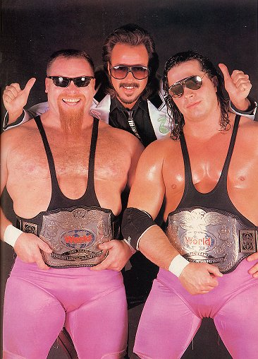
We had
champions…….

Slide 14
July 2009
The Good
  3rd party consultants
      user centric design
      provided multiple templates
      Drupal programmers
      were flexible on changes
  The Brock community was still on
  board, more or less

Slide 15
July 2009 – Sept 2010
Started to work together
Set realistic expectations
Communicated these expectations
Suspended training, until the system
was ready.
Remained flexible

Slide 16
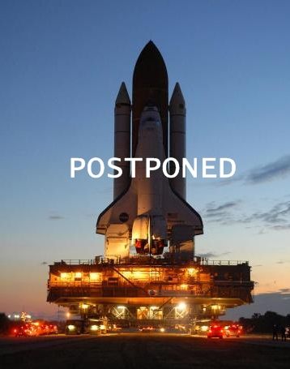
September 2010
Attempted 3 times
3rd time successful
Staggered launch

Slide 17
Since the launch
Only 2 academic departments are not on the
Drupal system
99% administrative departments are on the
Drupal system
Research and conference sites keep popping up
and moving over to the Drupal system
Trained and/or re-trained approximately 100
members of the Brock community
Over 800 support tickets came into
Marketing/Communications

Slide 18

Today’s Issues

Slide 19
Today’s issues
  need to tweak templates (AODA)
  improve calendaring and events
  security and customization
  build on functionality
  mobility
  work with content providers

Slide 20
Lessons learned:
  Need a champion(s)
  Good Project Management
    communication
    expectation
    documentation
  Prepare to support it after it’s
  implemented.

Slide 21

Planning and implementation:
Background
Home-grown CMS
Over 650 websites: majority of University
University community need for new/improved functionality
Need for modern, sustainable platform
Time for a design refresh

Slide 22
Planning and implementation:
Starting on the path to Drupal
The selection process
Moving in before the plumbing is finished
Piloting the project
Involvement with Drupal community
Project management

Slide 23
Planning and implementation:
Goals and objectives
Build new platform
Redesign the interface
Make content management easier for 1,200 editors/site managers
Improve usability for end users
Increase agility/responsiveness to emerging trends

Slide 24
Planning and implementation:
The migration plan
Move 650 websites: Oct. 2010 — Dec. 2011
Communications plan
Just-in-time training
‘8-step’ migration process
Schedules and timelines

Slide 25
Planning and implementation:
The roll out
Testing the migration tools
Site managers vs. Student workers
Support for rebuilding applications
Issues
Progress:
  194 sites migrated
  250 site managers/editors trained
  90% of site owners contacted

Slide 26
Technical choices and considerations:
Choices that affect site mgrs/editors
Consistency vs. Individual Branding
Flexibility vs. Conformity to Visual Identity Guidelines
WYSIWYG vs. Sound Mark-up
Flexible Layouts: blocks, WYSIWYG Template module
Individual Need vs. Generalized Solutions

Slide 27
Technical choices and considerations:
Managing themes and sub-themes
Legacy system: 150+ templates
Drupal: A single primary theme
Sub-themes: rarely used to ensure sustainability
Stringent guidelines for working with external designers: http://www.mcgill.ca/wms/wms-development

Slide 28
Technical choices and considerations:
Architecture and development
Hardware: servers and load balancer
PostgreSQL vs MySQL
Multisite vs. OG
Multisite management: Drush, Multisite Manager and Features
Solr for search

Slide 29
Technical choices and considerations:
Choosing the best solutions
Modules vs. configuration
Configuration: code vs. database
Contributed modules vs. custom modules
Selection criteria: User requirements, design aesthetics, user experience, accessibility, security, sustainability, longevity, standards compliance, Drupal support, hardware considerations.

Slide 30
Technical choices and considerations:
Moving forward: Drupal 6 to Drupal 7
Considerations in establishing a timeline:
Upgrade process: Complicated currently — waiting may yield improved solutions
Resources: Working at capacity with the main migration
State of contrib modules: Some will still be in alpha or beta
Drupal 6 end-of-life: Could be as soon as late 2012
Faculty and staff: Users will react badly to doing another migration so soon
Old resources/applications: Build in D6 and then port again to D7?
External resources:
  Creation/testing of migration tools could be farmed out...
  Replication of current toolset in D7 is best handled internally

Slide 31
Implementing Drupal
CANHEIT 2011

Slide 32
Presenters
Eva Grabinski
Web CMS Project Lead
Kris Olafson
Lead Web Developer

Slide 33
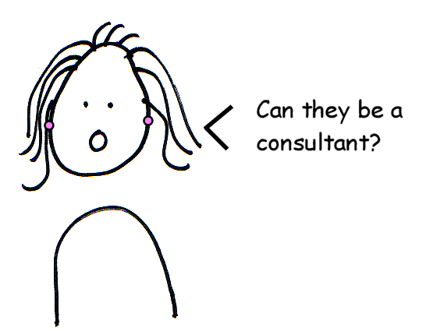

Implementing Drupal
S
So, you’re going with Drupal. Now what?

Slide 34
Software development project
Important to recognize that implementing Drupal is a software development project.
"Realize too that if you invest in a CMS, you’re now in the software business ...”
– the CMS Myth http://bit.ly/dZa6vu

Slide 35
Agile project management
Adopted agile PM methodology
Focus on the CMS as a product
Define features, releases, sprints/iterations
Training in agile PM
Using VersionOne as PM tool

Slide 36
Team roles
Project lead & manager (1)
Lead developer (1)
Backend developer (2)
Frontend developer (2)
System administrator (1)
Training-support UI lead (1)
Training-support specialist (1)
Accessibility expert (1)

Slide 37
Project timelines
Pilot project Sep 2010-2011
  Developed internal expertise in Drupal
  Created/creating some pilot & prototype websites
  First CMS product release Sep 2011
Early adopters Sep 2011 – Dec 2011
  Waterloo main site
  One to two faculty sites (aiming for 2)
  One academic support unit site
  Training and support site
Higher-pace rollout Jan 2012+

Slide 38
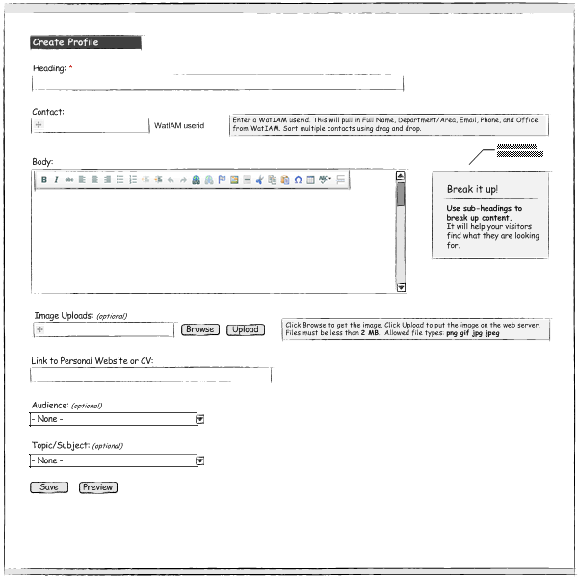
User interface (UI)
UI critical to success!
Number of users ~ 1000+
Critical to adoption
Eases training & support
Created mock-ups of content types
Assessing usability & accessibility
Performing end-user testing (testing plans and testing protocols)

Slide 39
External consultants
Lessons learned by other universities
Focus on developing internal expertise
Potential performance optimization consulting services

Slide 40
Resources
Lullabot training videos
Drupalcon
DrupalCamps
Other universities
  IRC (irc.freenode.net #drupal-highered)
Local Drupal user groups

Slide 41
Challenges
Moving from de-centralized to centralized
Supporting transition from tools A to B – migration & support for both
Conveying content types vs. web pages
Technology as solution to content woes
Areas eager to move into a CMS quickly - requires significant time-and-resource investment

Slide 42
Tips and lessons learned
Communicate with other universities
Treat implementation as software project
Order: usability; wireframes; CMS; design
There is lots of design & theming work -well after new design concept delivered
Caution about thinking Drupal is easy – there is a significant learning curve for large implementations
Notes:
Diplomacy and patience

Slide 43
A brief history
Began working with Drupal 6 under Red Hat Enterprise Linux 5.6
Moved to Drupal 7 under Red Hat 6.0 in January
Drupal 7 was still in beta when we started work, so we learned the ropes in version 6 as it was considerably more stable at the time

Slide 44
Why move to Drupal 7
Major UI improvements
Support for Drupal 6 contributed modules will slow down or stop in favour of Drupal 7 modules
  Many new contributed modules will be Drupal 7 only
RDFa supported in Drupal 7 core
Database improvements (master/slave replication etc.)

Slide 45
Servers
Mostly virtual machines
  Sandbox: Personal sites for building modules and themes and testing contributed modules
  Development: Collaborative workspaces for team members to build sites together
  Staging: Where final touches are put on sites before they go into production and updates can be tested before they go live

Slide 46
Servers
Production: Will house all sites of the form “uwaterloo.ca/OrgUnit”
Varnish: Caching servers – cache un-authenticated pages and images
Capabilities: Will house more social sites like blogs, event listings and forums that require more authenticated users
  More logins = less caching
  Better to separate these sites for scalability

Slide 47
Servers
SOLR: Search engine used for in-house indexing of production sites
Memcached: Yet more caching, currently caching temporary tables in Drupal
Subversion: Version control server manages in-house development and site configuration files
uwat.ca – a URL shortening service

Slide 48
Deployment strategy
Multi-site deployment
Faculties, schools, departments and support units all get their own Drupal installs
We will have 100s of sites when fully deployed, with authentication managed centrally through CAS
We will be using a layered installation profile approach where a group will receive an install that most closely meets their needs

Slide 49
Deployment strategy
Sites can be rolled out (mostly) pre-configured thanks to the Features module
The Features module lets you move configuration settings from the database into code so they can be version controlled
  This lets you keep track of changes to site configuration over time
Features will allow us to roll out configuration changes to multiple sites by altering code in one place rather than additionally updating multiple databases

Slide 50
Deployment strategy
Not all Drupal contributed modules currently work with the Features module, although there is a big push for this
If a module doesn’t support Features, you can add Features support with the Chaos Tools Suite
This can be trivial or quite difficult depending on the module
If attempting to add Features support to a module, you should work closely with the module maintainer so your changes are contributed back to the community

Slide 51
Deployment strategy
  We have a “Features Server” site that houses any features, modules, themes, patches, install profiles and distributions that are not useful outside the uWaterloo community
    Anything that isn’t a good candidate to be posted on Drupal.org
  It functions as a scaled down version of Drupal.org
    Deployed features, modules and themes can reference the Features Server to check for recommended updates and security patches
    It has a release history for the code that it houses
    It can be expanded to include social interaction features for collaborative efforts and improved documentation

Slide 52
Proposed open source model
Following Drupal tradition, hope to open source all of our code and share it on our Features server in September
Drupal developers across campus will be able to contribute to existing projects or start new ones
We will share code with other higher-ed institutions as well, but some things may not be useful outside uWaterloo

Slide 53
Design and theming
Our Drupal themes were modeled after the designs we received from the uWaterloo redesign project
In addition to our front-facing themes, we have also developed a sub-theme to the Drupal admin theme with accessibility improvements

Slide 54
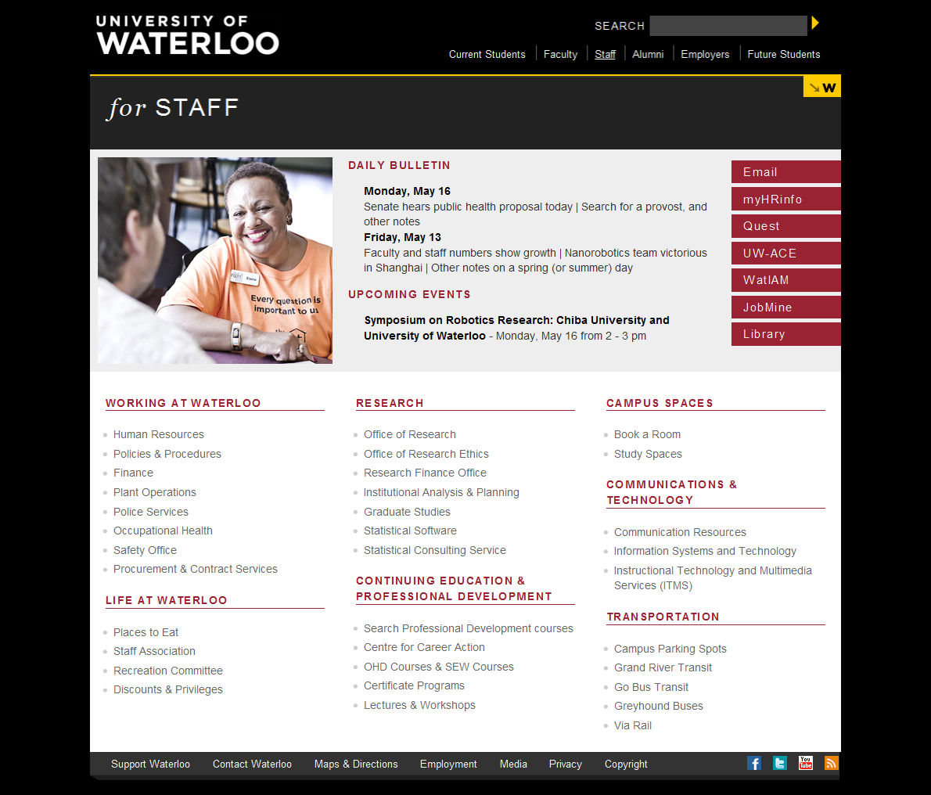

Slide 55
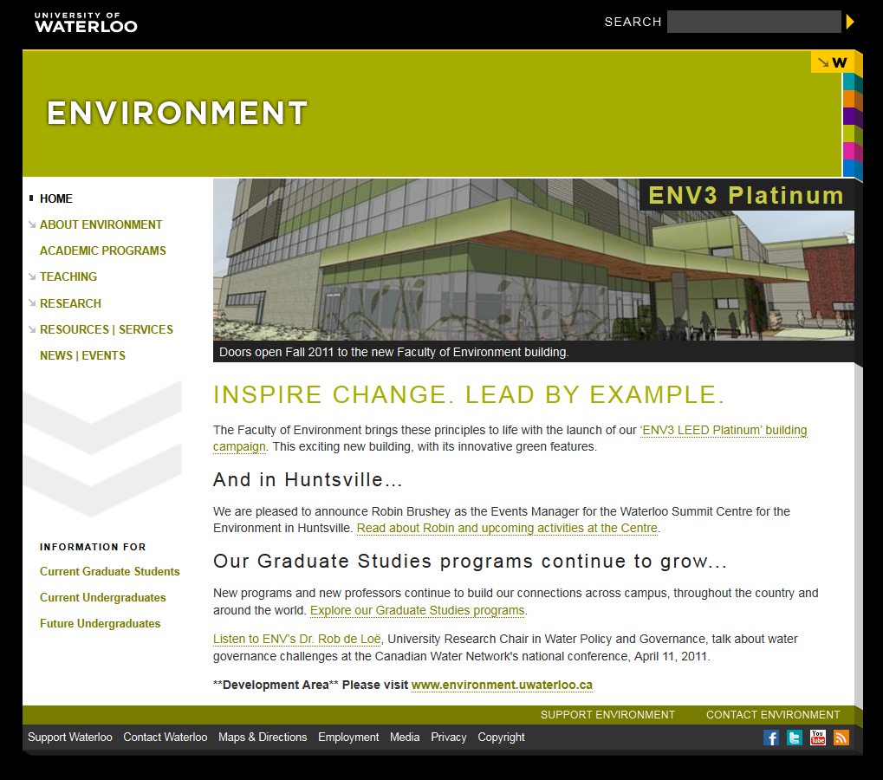

Slide 56

Introduction – a little bit of history
  old site built on a home-grown CMS (Lotus Notes)
  mStoner – review, 2007
  implementing mStoner’s recommendations
    search for a CMS. May 2 to July 25, 2008
    building it out – two distinct streams of activity
      the technical side – Drupal themes and modules (Global Image)
      the design side (mStoner)
      accessibility
      top down approach. Homepage first.
      live on June 14, 2009.

Slide 57
Drupal – Theming
15 Total Drupal themes done by consultant.
  Home Page Site, Law Department Site and Odette School of Business were “one off solutions.
  12 “Departmental” (Sub-site) Themes.
    They were mostly duplicates with different names (ex: ‘Education’ Theme was the same as ‘Innovative’ Theme which was the same as ‘Innovative Burgundy/Green’ Theme).
  So we actually only received 4 themes.

Slide 58




Drupal – Theming (cont’d)
Even these 4 themes were actually identical, with the exception of colour schemes.
We had to “unify” these themes into one, easy to manage and configurable theme once the consultants left.
  Problem was that we already had over 100 sites using one of the 12 themes.
  WCAG 2.0 Compliance, we were close, colours had to be tweaked.

Slide 59
Drupal – Modules (from mStoner)
Received 2 modules from mStoner/Global Image.
“Global Blocks” module
  some banner settings were configurable on the home site
  an attempt at News sharing between sites (not using aggregation for some reason).
  Most of this module has been scrapped.
“Block Sections” module
  allowed nodes to be assigned to “block sections” which determined block visibility settings.
  Still in use, necessary evil.

Slide 60
Drupal – Modules (in-house)
News and Events Module
  Allows for complete management, including import and export of News and Events between sites (and beyond), using RSS and iCAL formats.
  Contains user-friendly calendar views of events (using the Calendar module).
  Heavily leverages/integrates with CCK, Views 2, Feeds Modules.
LDAP Sync Module
  An extension of the LDAP Integration module, which synchronizes all LDAP users with your Drupal users.
  Can run on schedule as part of cron.
  Allows for LDAP filters to limit which users get imported.
  Also imports users’ roles, where available/applicable.

Slide 61
Drupal – Modules (in-house)
Video Module
  Allows for embedding of HTML5 Video into Drupal sites.
  Integrated with WYSIWYG (CKEditor) editor.
  Fails gracefully, reverts to regular JW Player Flash player.
Advanced News Module
  For use on News-only sites.
  Provides additional functionality and features for the “more advanced” content providers (ex: Public Affairs and Communications Department).
  Integration with Facebook API
  Subscription and mail capability.

Slide 62
Drupal – Other Specifications
Drupal Updates
  We update Drupal quarterly, which ends up working out to approximately every second release.
  Getting more and more time consuming to update all of the sites (total of 480 sites currently).
Organic Groups vs Multi-Site
  We run a solely Multi-Site based configuration (decision was made for us).
  In retrospect, perhaps a hybrid solution would be ideal and allow us to leverage the advantages of both.
    ex: Faculty of Science would be one site, and sub-sites (Biology, Chemistry, etc.) could be handled using O.G.
    Instead of having 500 sites, perhaps have 20-50.

Slide 63
Drupal – Search
Google Search Appliance
  We were originally advised to only get a Google Mini.
  Bought a Google Search Appliance instead, already reached the 500,000 documents that our license allows.
  Integrates fairly well using the Google Search Appliance Integration module.
Apache Solr
  Currently are investigating a move to Solr as the GSA could get pricey to add more documents.
  Hoping to have Solr working sometime in the Fall 2011 – Winter 2012.

Slide 64
Drupal – System Architecture
Production Servers:
  2xDell PowerEdge R805 servers.
    Originally, the system architecture was going to be all virtual servers, but we changed it before going production.
    Each server runs its own instance of Apache and share the data using NFS mounted drives (no worries about replication).
  F5 BigIP Load Balancer.
    Distributes load between available servers.
Staging Server:
  1xDell PowerEdge R805

Slide 65
Drupal – Drupal Staff
Training and Content Editor support
Drupal Administration and Development

Slide 66
Drupal – Going Forward
Drupal 7
  We will upgrade to Drupal 7 when our site gets a new design again.
  Web Management Committee along with Public Affairs and Communications department will decide the exact timing.
In the meantime, additional functionality
  Easy to use Blogging functionality .
  Mobility?

Slide 67
Implementing Drupal
classes for content providers during the first summer, 2009.
  good history of centralized Web development
  so lots of buy-in. People were pumped for this.
  new class every week (max. 16 people)
  about 150 people received training in about 80 departments (10 weeks)
Fall to the present – frequency of classes reduced to once a month. Down from 4 to 2 days.

Slide 68
Implementing Drupal
  training people in a construction site
    things were changing that first summer every day
  developing documentation on the fly

Slide 69
Implementing Drupal
Content provider forums – every other month
  discuss topics of interest to content providers
  presentations, etc.
  lecture hall format
Drop-in sessions
  about once a week
  in a hands-on Lab environment
  informal, open-ended discussions on how to do things in Drupal

Slide 70
Implementing Drupal
Where are we now?
  270 sites in production and an additional 210 sites on staging server
  AODA compliant but requires ongoing vigilance, assessments
Challenges.
  a few departments left – done by summer?
  many, many personal, research, etc. sites.

Slide 71
If we had to do it over, what would we do different?
  so many, but the short version …
  give yourself some time to think
  talk to others who have done this.
  make sure your consultant knows Drupal
  manage expectations.
    this is going take longer than you think
  do it in-house or get a consultant?

Slide 72
Thank You.
Questions?

